Slide 1
PACKET TRACER

Slide 2
Packet Tracer is a medium fidelity, network-capable, simulation-based learning environment for networking novices to design, configure, and troubleshoot computer networks.
Packet Tracer is an integrated simulation, visualization, collaboration, and assessment environment.
Packet Tracer relies on a simplified model of networking devices and protocols.

Slide 3
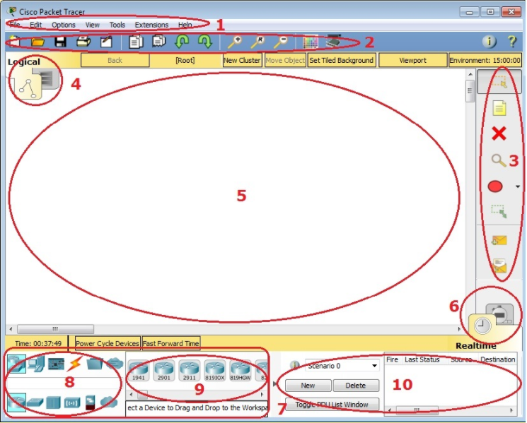
Menu Bar

Slide 4
Menu Bar
Main Tool Bar
Common Tools Bar
Logical/Physical Workspace and Navigation Bar
Workspace
Realtime/Simulation Bar
Network Component Box
Device-Type Selection Box
Device-Specific Selection Box
User Created Packet Window

Slide 5
Workspaces and Modes
Packet Tracer has two workspaces (Logical and Physical) and two modes (Realtime and Simulation).
Upon startup, you are in the Logical Workspace in Realtime Mode.
You can build your network and see it run in real time in this configuration.
You can switch to Simulation Mode to run controlled networking scenarios.
You can also switch to the Physical Workspace to arrange the physical aspects (such as the location) of your devices.

